Slide 1
13 – Clean Code – Dependency Inversion Principle (DIP)
Based on the CleanCoders videos by Uncle Bob Martin
Rupert Waldron

Slide 2
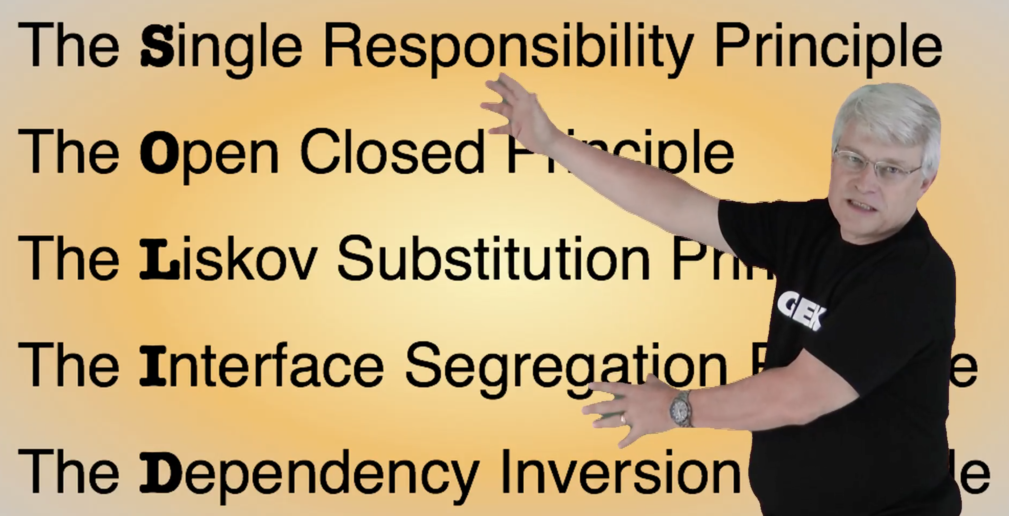
Object Orientated Design is all about Dependency Management
Uncle Bob gives us these dependency management principles that control operations and relationships between classes

Slide 3
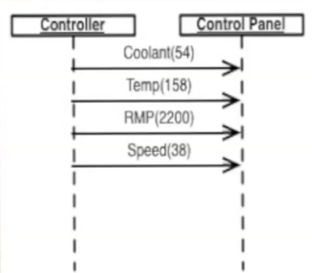
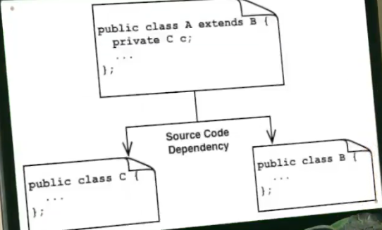
What is dependency?
Runtime Dependency is when two modules interact at runtime.
Compile time dependency is when a class appears in another class.

Slide 4
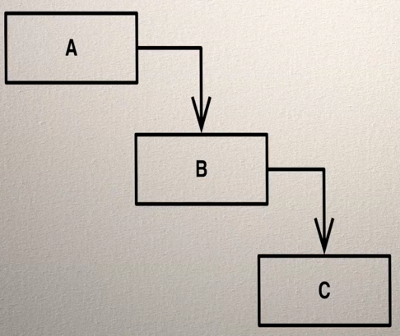
Compile Time Dependency
In order to compile A, the Java compiler must first find out about B and to compile that it must find out about C.
The compiler will first do this by looking for B.class, but if the class file is older than the B.java file then it will recompile B.java into B.class. The it will read the details about B from B.class. In order to compile A, you must compile all the modules it depends upon.
Compile time is not so much of an issue today as it once was. However, deployment is still an issue – re deploying lots of module files - jars.

Slide 5
Independent Deployability
Why is independent deployability important?
1) Don’t have to recompile lots of modules if you make a change.
2) If there are lots of teams then having to recompile the code and redeploy – re-release a library and upload it to nexus.
This causes confusion, errors and results in slower and more difficult development.

Slide 6
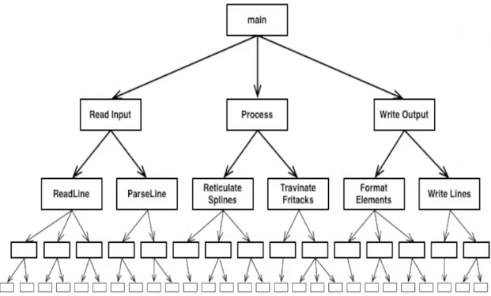
Structured Design
Structured Design is a top-down methodology – layout the dependencies and then write the code
The source code dependency (compile time dependency) is an exact mimic of the runtime dependency
The high-level design/policy is now based on low level concretions. How easy is it to modify this code?

Slide 7
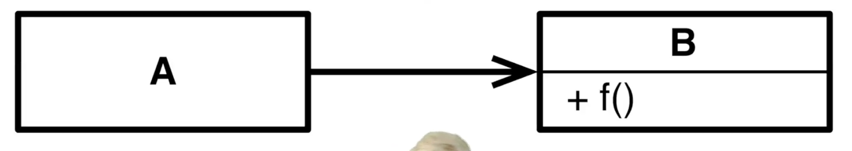
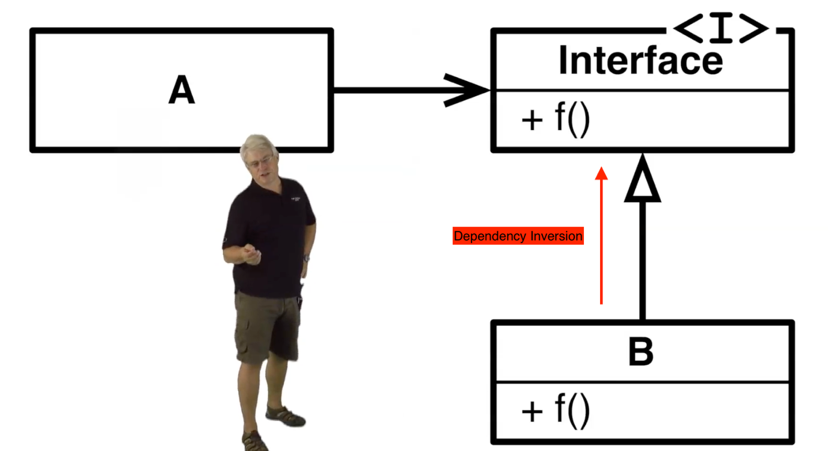

Dependency Inversion
A calls f() on B. Then A has both a runtime and compile time dependency on B
Now use an interface to make the call polymorphic. A uses the interface, B would implement it. A still has a runtime dependency on B, but it doesn’t have a compile time dependency. A and B both have source code dependencies on the interface

Slide 8
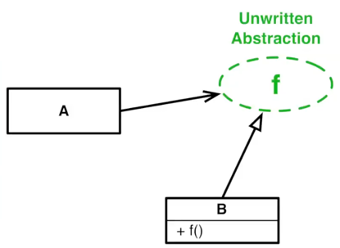

Dependency Inversion – In Dynamic Languages
For dynamic languages such as Ruby and Python there is no interface – they use duck-typing. There is no source code dependency on an abstraction/interface.
Dependencies are inverted when the source code dependencies oppose the direction of the flow of control

Slide 9
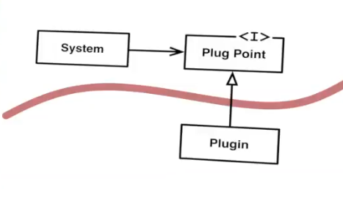
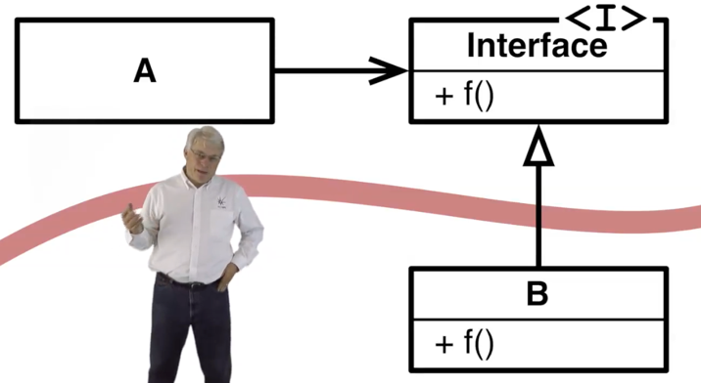
Plugins
We choose where to invert the flow of control so that all dependencies pass in one direction across the boundary.
This is how we create plugins.
A plugin is a module that is anonymously called by another module
Inverting dependencies is the way we create boundaries between software modules

Slide 10
Definition
Dependency Inversion Principle – High level policy should not depend upon low level detail. Low level detail should depend on high level policy

Slide 11
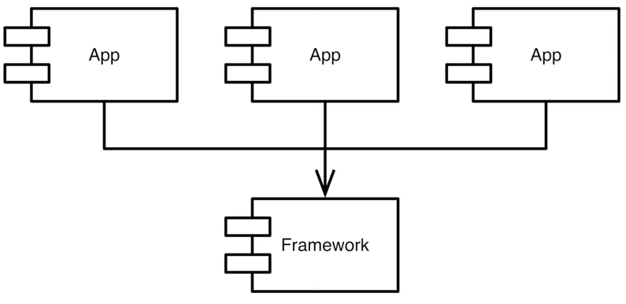
Frameworks
The framework contains the base classes which are implemented by the Apps.
E.g. Spring, Operating Systems with IO Drivers
When designing a framework there should be no dependency by the framework on the application. The high level policy is no longer dependent on low level detail – dependency inversion.
The apps can be develop independently

Slide 12
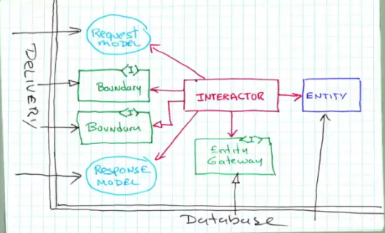
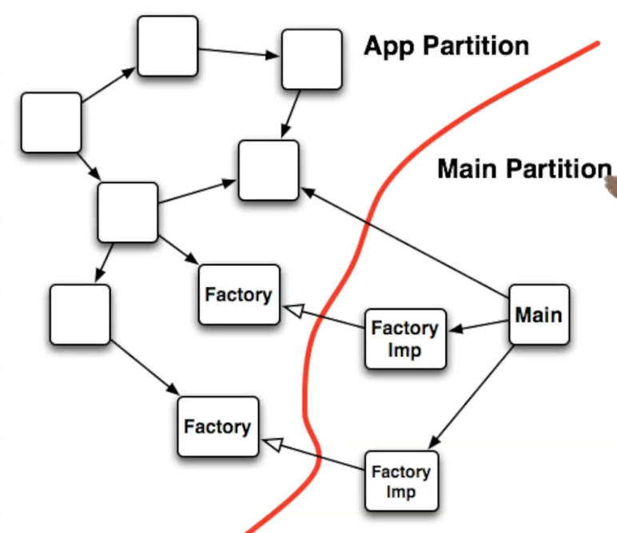



More on plugins
Plugins define the boundaries of your system. You create the boundaries by inverting the dependencies across them and then treating the boundary as a plugin interface.
Main should be a plugin to the rest of the application
A good architecture is a plugin architecture which is created through careful use of the dependency inversion principle.

